Slide 1
ICCA Rules Review
2015-2016

Slide 2
ICCA & IHSA follow NFHS Spirit Rules
New rule changes for the season
Rule situations and interpretations
Clarification of established rules
ICCA changes
ICCA season info

Slide 3
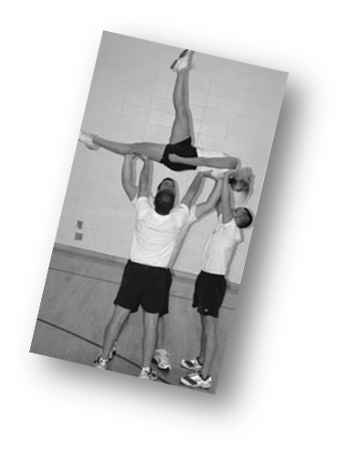
Revised definition . . .
Flatback - A stunt in which a top person is in a face-up or face-down horizontal position, with hips and shoulders in alignment.

Slide 4
Revised Definitions…
Quick Toss - A release that begins with the top person in weight-bearing contact with the performing surface and ends in a partner stunt or pyramid.
Toss - A release stunt in which the base(s) begin underneath the top person’s foot/feet and execute a throwing motion from below shoulder level to increase the height of the top person. The top person becomes free from all bases, spotters, posts or bracers.

Slide 5
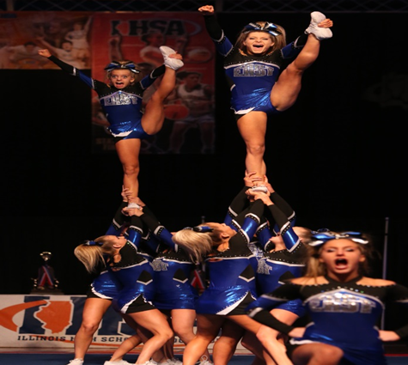
Rule 2 – General Risk Management

Slide 6
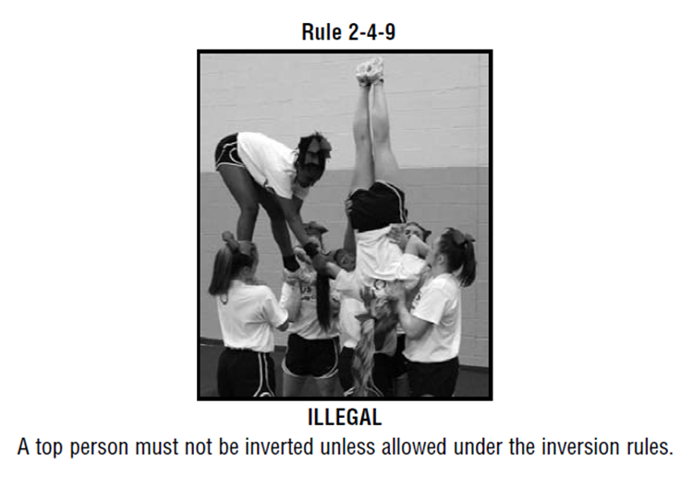
Inversions 2-5
ART 1 . . . Unless allowed under the rules in this section, a top person must not be in an inverted position.

Slide 7
Inversions 2-5-2
(no change from last year)
ART. 2... Suspended rolls are allowed provided:
a. Two people on the performing surface control the top person with continuous hand-to-hand/arm contact to a stunt, two-person cradle, loading position or the performing surface.
b. A single base or post controls the top person with continuous hands-to-hands contact to a stunt, two-person cradle, loading position or the performing surface.
NOTE: A single base/post suspended roll that ends on the performing surface requires a spotter.
c. If caught in a cradle, load or stunt, the new catchers are in place and are not involved with any other skill when the suspended roll is initiated.
d. The feet/ankles of the top person are released.

Slide 8
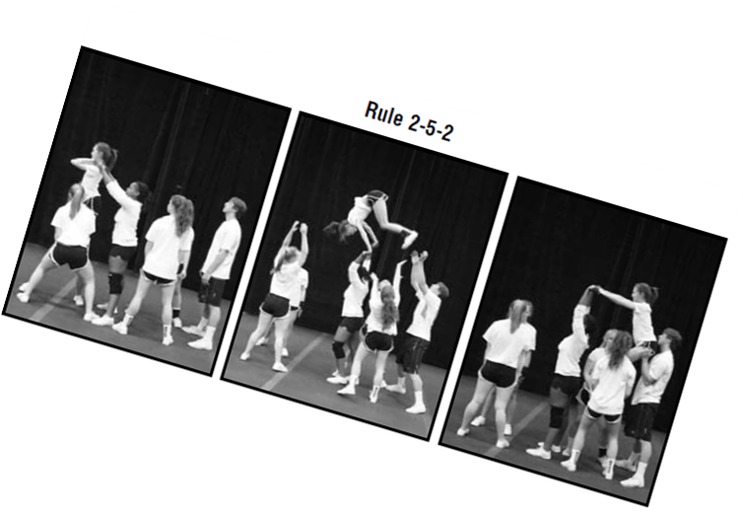

Slide 9
Inversions 2-5-3
ART 3…Braced inversions in a pyramid that do not flip or roll are allowed provided the following conditions are met:
a. The top person does not begin in an extended inverted position.
b. Braced inversions that do not release must follow non-release stunt rule 2-6.
c. Braced inversions that release must follow the release transition rule 2-7-5.

Slide 10
2-5-4 Inversions
ART. 4 . . . Braced flips or rolls in a pyramid are allowed provided all the following conditions are met:
a. The top person begins in a multi-base loading position, stunt, cradle, or on the performing surface.
b. The top person does not begin in an extended inverted position.
c. The top person maintains continuous hand-to-hand/arm contact with a bracer on each side. The bracers are in multi-base preps with a spotter. The top person is between or in front of the bracers.
d. At least three catchers (one base and two spotters or two bases and one spotter) who were the original bases/spotters catch the top person in a loading position, stunt or cradle, or assist the top person to the performing surface. If the flip ends in a cradle, the bracers may release the top person once she/he begins to descend and is no longer inverted.
e. The top person ends in a non-inverted position.
f. The top person does not perform more than one and one quarter (1¼) flipping rotations and no more than one half (½) twist.
g. The bases/catchers remain stationary except as necessary for safety adjustments.

Slide 12
ART. 5…In all other inversions:
An inverted top person is allowed to pass through an extended position, but must not pause or stop while extended
b. In inversions where the base of support begins and remains below prep level:
1. At least one base or spotter must be in a position to protect the head/neck of the top person.
2. The base or spotter must maintain contact with the top person’s upper body (waist and above, which may include arms/hands) until the top person is no longer inverted or his/her hands are on the performing surface. The contact must be sufficient to stabilize/control the top person’s position.
EXCEPTION: A top person in an inverted position on the performing surface may be released to a loading position below shoulder height.
c. In inversions where the base of support begins at or passes through prep level:
1. At least two people on the performing surface must be in a position to protect the head/neck of the top person.
2. The bases/spotters must maintain contact with the top person’s upper body (waist and above, which may include arms/hands) until the top person is no longer inverted or his/her hands are on the performing surface. The contact must be sufficient to stabilize/control the top person’s position.
EXCEPTION: In a foldover stunt, the top person may initiate the inversion without upper body contact.
3. The top person must not go directly to an inverted position on the performing surface from prep level or higher.
d. Dismounts from inverted stunts to a cradle or an upright position on the performing surface are allowed provided the top person begins in a static or “pump and go” position (i.e., handstand) and does not perform any skill (e.g., toe touches, twists, etc.). Dismounts to the performing surface from shoulder height or above must follow Rule 2-9-2.

Slide 13
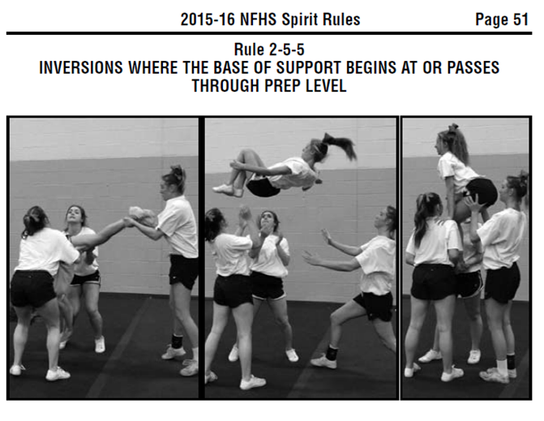
BOOK CORRECTION
Page 49 explanation on exception to rule 2-5-5a belongs with the picture on page 51

Slide 14
Book Correction
ILLEGAL 2015-16

Slide 15
INVERSION

Slide 16
ILLEGAL INVERSION

Slide 17
Rule 2-5-6
ART. 6 . . . An inverted top person must not hold objects (poms, signs, etc.) in his/her hands, except during a transition from an inverted position on the performing surface to a non-inverted stunt.

Slide 18
Rule 2-5-6
SECTION 6 – NON-RELEASE STUNTS…
(P) ART 4 . . . A top person may be moved from a vertical position to a horizontal position (straight body or cradle) provided all the following conditions are met:
a. The top person maintains contact with at least one original base or spotter.
b. At least two catchers and/or bases catch the upper body of the top person.
c. The catchers must be to the side or front of the person(s) moving the top person.
d. When the catchers are not the original bases, they remain close to the original bases and are in place prior to the movement to the horizontal position.
e. When the catchers are not the original bases and the top person begins or passes through an extended overhead position, three catchers are in place.

Slide 19
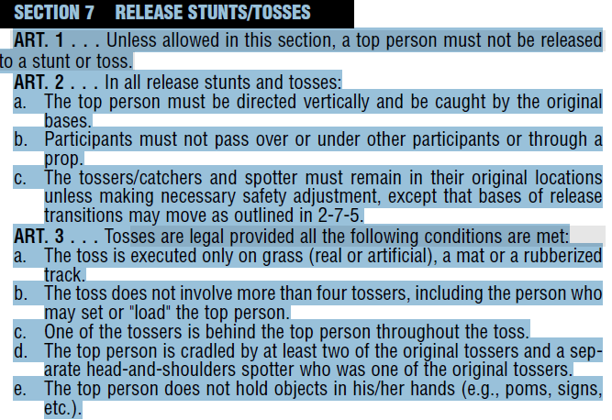
Rule 2-7-1 & 3
ART. 1 . . . Unless allowed in this section, a top person must not be released to a stunt or toss.
ART. 3 . . . Tosses are legal provided all the following conditions are met:…

Slide 20
Rule 2-7-4
ART. 4 . . . Quick tosses are legal provided all the following conditions are met:
a. The toss does not significantly exceed the height of the intended stunt.
b. The base(s) apply upward force on any part of the body other than under the foot/feet. EXCEPTION: A switch liberty is permitted.
c. The top person is not caught under the legs in a split or straddle position in a stunt shoulder height or above.

Slide 21
Rule 2-7-5
(P) ART. 5 . . . Release transitions are legal provided all of the following conditions are met throughout the transition:
a. The skills before and after the release must be legal, including the required spotters.
b. The top person maintains hand-to-hand/arm contact with at least one bracer. Exception: A non-braced tick tock that begins at or below shoulder level is allowed.
c. The top person and each bracer have a separate spotter with the exception of bracers in shoulder sits and thigh stands.
d. The bracers do not provide primary support for the top person.
e. The released top person and bases make no more than a ¼ turn around the bracer in a continuous movement in which the top person remains vertical over the base(s).
f. The top person must be caught by original base(s).

Slide 22
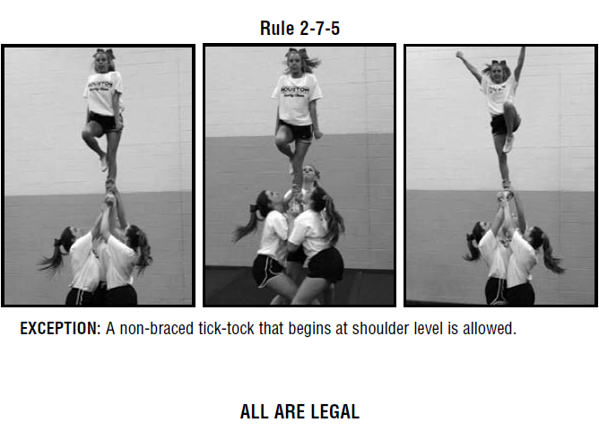
A non-braced tick tock that begins at or below shoulder level is allowed.

Slide 23
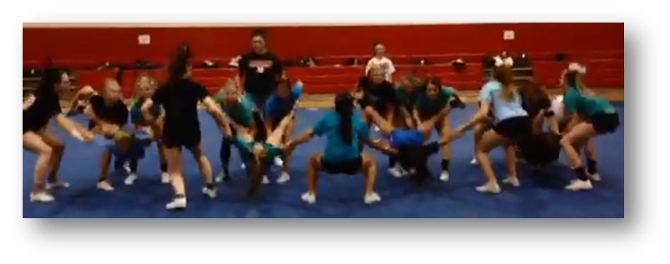
Rule 2-8-6
ART. 6 . . . A top person must not be in a face- down position between bases in which the top person’s torso is suspended below the arms and legs.

Slide 24
Rule 2-10 Tumbling
ART. 7 . . . Airborne skills without hip-over-head rotation may not involve jumping from a standing or squatting position backwards onto the neck, shoulders or hands. This rule refers to a type of entrance into the “kip-up/rubber band” skills.

Slide 25
Rule 2-11 DROPS
ART. 1 . . . Airborne drops that go directly to the thighs, splits, knees, seat or the performing surface are illegal unless most of the weight is first borne on the hands or feet or the descent is controlled.
ART. 2 . . . Airborne drops to a push-up position, including Shushunovas, are illegal.
Exception: Springing from a crouch to a push-up position is allowed.
ART 3….Falling from a stand directly to the stomach or back on the performance surface is illegal without first bearing weight on the hands.
ART. 4….Dropping to the performing surface from a handspring or flip is illegal.

Slide 27
BOOK CORRECTION
Situation p. 15 (a) legal (b) illegal

Slide 28
Situations
2.5.2 SITUATION B: A participant in a prep grasps the hands of a post who is standing in front of the stunt and executes a suspended forward roll over the post, landing in the hands of new bases that were involved in a suspended roll immediately prior to moving in front of the post to catch the cradle.
RULING: Illegal. COMMENT: Catchers of suspended rolls that end in a cradle must be in place when the roll is initiated.

Slide 29
Situations
2.5.4 SITUATION A: The top person in a braced flip is assisted by: (a) one bracer in a double-base prep and one person on the floor; (b) two bracers in single-base preps; (c) two bracers in double-base preps.
RULING: (a) and (b) illegal; (c) legal

Slide 30
Situations
2.5.5 SITUATION C: Two participants are: (a) standing back to back with their arms hooked together. The base leans forward as the top person does a backward roll over the base’s back and lands upright on the performing surface; (b) facing each other; the top person performs a handstand over the shoulder of the spotter into a loading position. While assisting the top person during the transition, the spotter does not turn around until the top person is in the loading position.
RULING: (a) illegal; (b) legal. COMMENT: By facing away from the inverted top person, the base or spotter is not considered to be in a position to protect the head/neck.

Slide 31
Situations
2.5.5 SITUATION G: A top person is based by two persons at waist level. She is transitioned to a prep position, and then cartwheels to her feet on the performing surface with: (a) one spotter maintaining upper body contact; (b) two spotters maintaining upper body contact.
RULING: (a) illegal; (b) legal. COMMENT:
All inversions that begin or pass through prep level must have two bases or spotters maintaining upper body contact.

Slide 32
Situations
2.5.6 SITUATION B: A top person in a handstand on the performing surface is lifted to a prep while holding a sign.
RULING: Legal.

Slide 33
Situations
2.6.4 SITUATION A: The top person in a double-base prep falls forward and is caught on her upper body by the two original bases: (a) while a spotter/post maintains contact with the top person’s ankles; (b) after being released so
bases/spotter can catch higher on the top person’s body.
RULING: (a) legal; (b) illegal.

Slide 34
Situation
2.7.5 SITUATION C: A team executes a single-base, non-braced tick-tock that begins: (a) at shoulder level; (b) above shoulder height.
RULING: (a) legal; (b) illegal. COMMENT: Non-braced tick-tocks that begin at shoulder level do not require the top person to maintain contact with a bracer when performed with a single base or with multiple bases.

Slide 35
Situation
2.9.3 SITUATION: A top person in a single-base prep is popped and executes: (a) a twist to the floor with the assistance of the base and a spotter; (b) a toe touch during the dismount with the assistance of the base and a spotter.
RULING: Both are legal. COMMENT: Assistance is required on dismounts to the ground involving a skill that begins from shoulder level or above.

Slide 36
Rule Reminders
Keep hair up/off shoulders
No jewelry

Slide 37
2015-16 Season Info
Jr. High divisions are determined by team size
Teams must be an ICCA member to be considered for all ICCA awards and recognition.
Qualifying scores for ICCA
Jr. High = 68%
Non-Stunt = 70% (jr. high division)
JV = 70%
Varsity = 80%

Slide 38
Jr. High Routine Elements
Teams should perform an unstructured routine which may utilize music and cheer.
Total routine may not exceed 3 minutes.
Music may not exceed 1:30.
NO BASKET TOSSES are allowed.
Four alternates allowed

Slide 39
FOR ICCA COACHES
Contact your region representative if you have questions or concerns.
Reg. 1 Holly Baumgarten holly.baumgarten@yahoo.com
Reg. 2 Valerie Mallon mallonv@comcast.net
Reg. 3 Kara Bent kjbee15@hotmail.com
Reg. 4 Libby Moore cheer2libby@gmail.com
Reg. 5 Cheryl Haselhorst cah614@hotmail.com
Chicago Nicole White white.nicole@gmail.com

Slide 40
GOOD LUCK
HAVE A GREAT
2015-16 SEASON !
Print this page

